Slide 1
Introduction to Software Engineering
Process Model- Agile Development
Mobeen Nazar
Lecturer
Software Engineering Department

Slide 2
Objective
Agile Development
Agile methods
Agile Capability
Agile Techniques
Scrum

Slide 3
Rapid software development
Rapid development and delivery is now often the most important requirement for software systems
Businesses operate in a fast –changing requirement and it is practically impossible to produce a set of stable software requirements
Software has to evolve quickly to reflect changing business needs.
Plan-driven development is essential for some types of system but does not meet these business needs.
Agile development methods emerged in the late 1990s whose aim was to radically reduce the delivery time for working software systems

Slide 4









Plan-driven and agile development

Slide 5
Plan-driven and agile development
Plan-driven development
A plan-driven approach to software engineering is based around separate development stages with the outputs to be produced at each of these stages planned in advance.
Not necessarily waterfall model – plan-driven, incremental development is possible
Iteration occurs within activities.
Agile development
Specification, design, implementation and testing are inter-leaved and the outputs from the development process are decided through a process of negotiation during the software development process.

Slide 6
AGILE IS A SET OF VALUES AND PRINCIPLES.

Slide 7
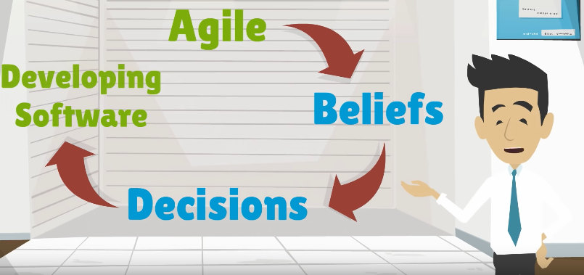
Agile is really a collection of beliefs that teams can use for making decision about how to do the work of developing software.
Agile is flexible. It doesn’t make decisions for you. Instead it gives a foundation for teams to make decisions that result in better software development.

Slide 8
Agile manifesto is only 68 words and very simply says that we can develop software better by valuing the items on the left side of the list more than the items on the right side.

Slide 9
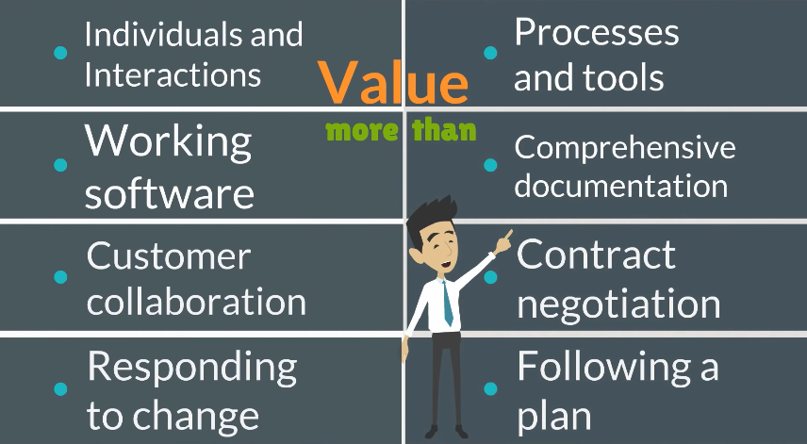

Slide 10
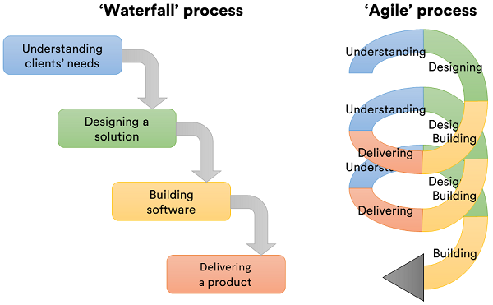
Agile Vs Waterfall

Slide 11
In addition to the values of the manifesto, there are 12 principles that support the values.
Once again the principles are very general and are less about telling you what to do than they’re about giving you the ability to make a good decision in a particular situation.

Slide 12
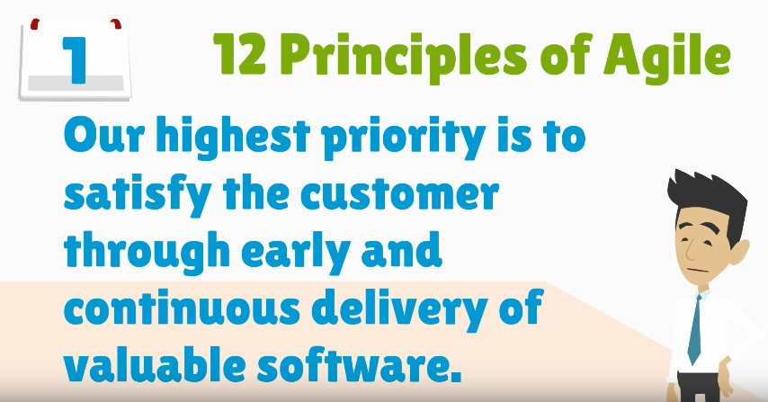

Slide 13
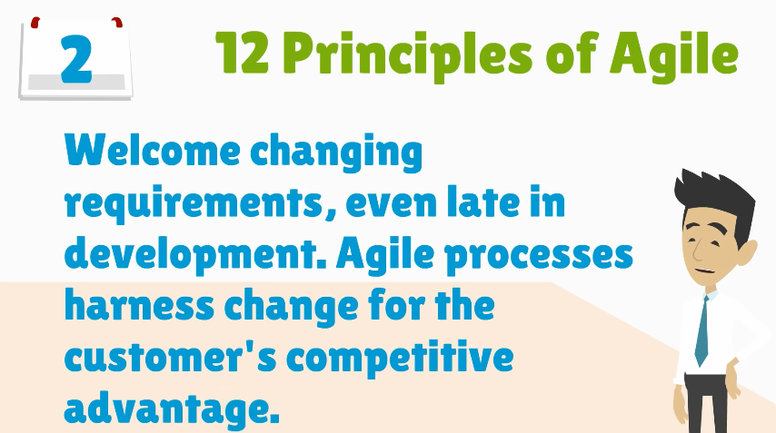

Slide 14
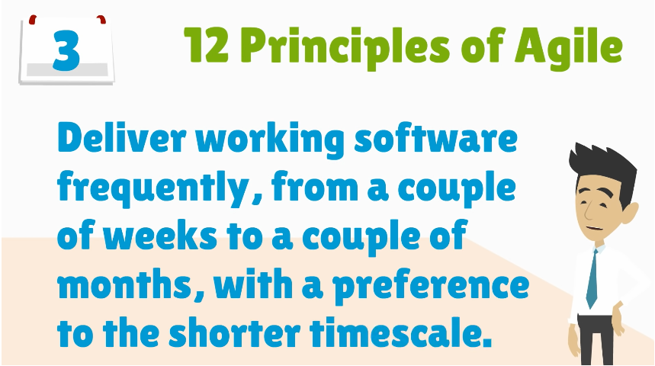

Slide 15
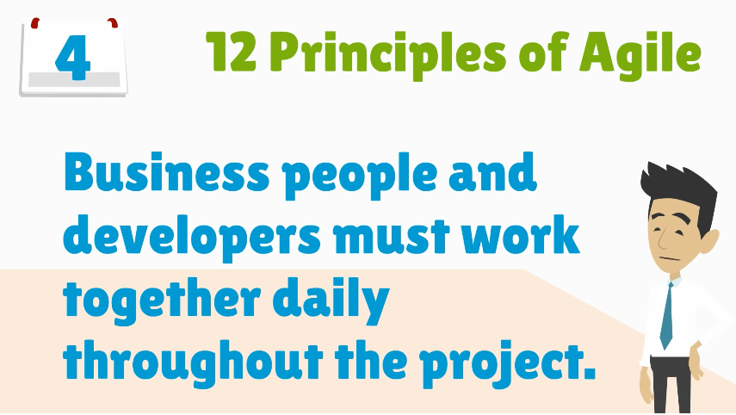

Slide 16
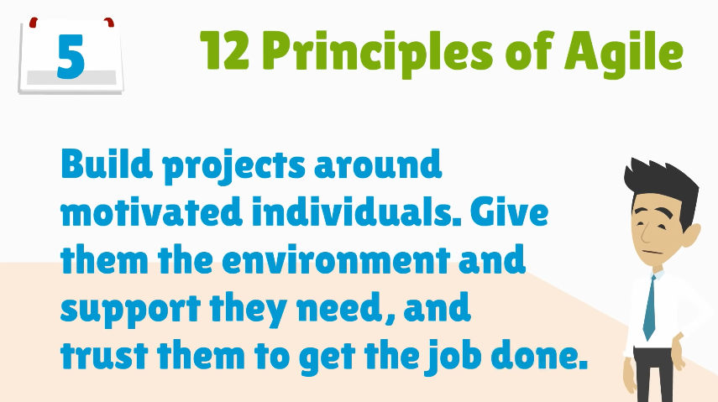

Slide 17
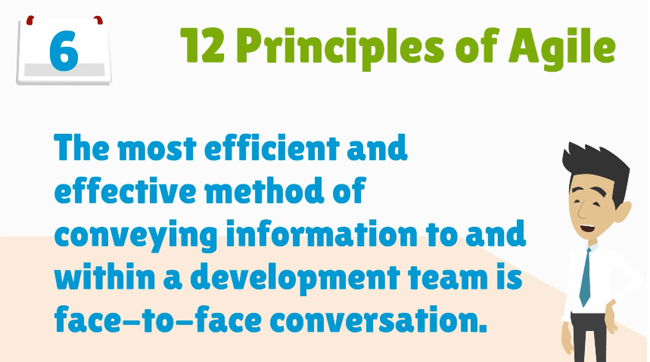

Slide 18
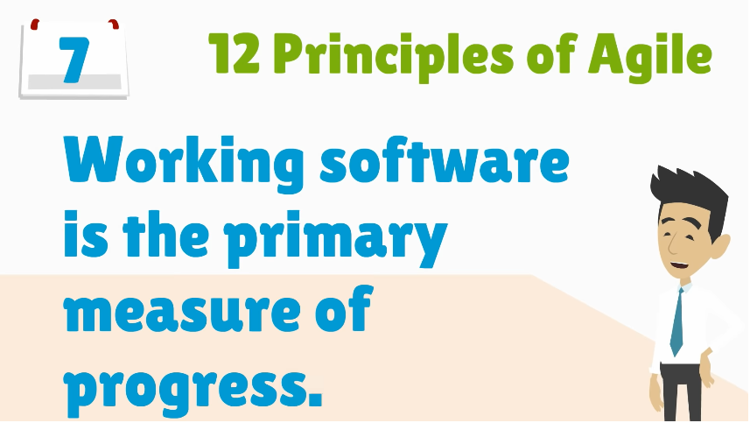

Slide 19
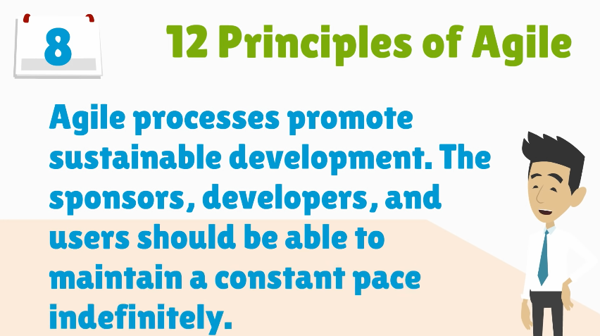

Slide 20
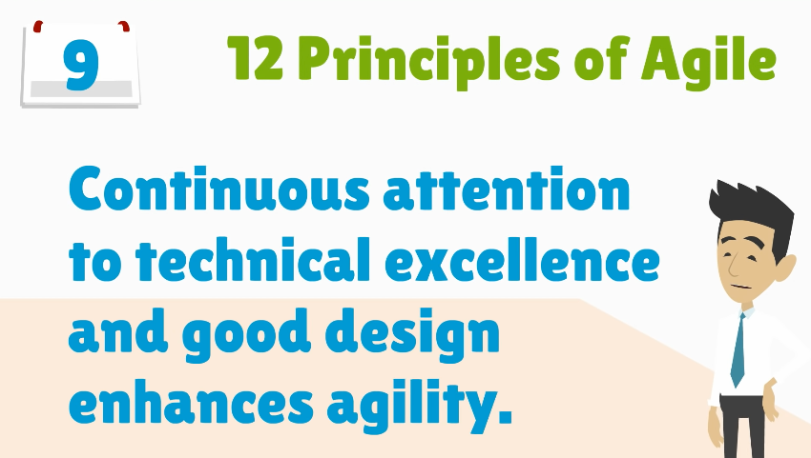

Slide 21
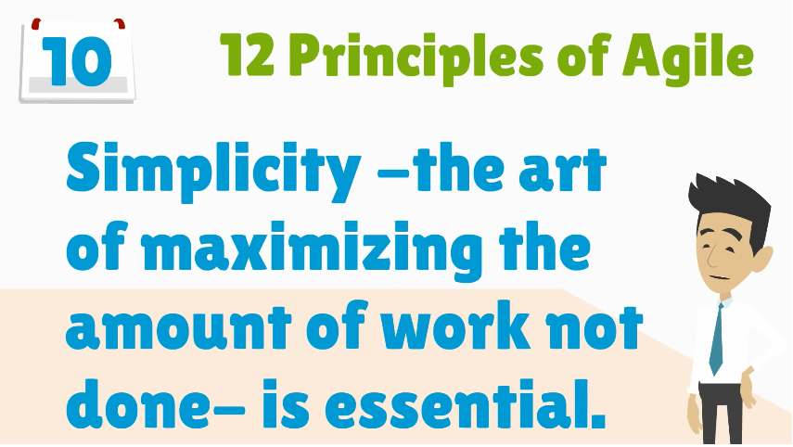

Slide 22
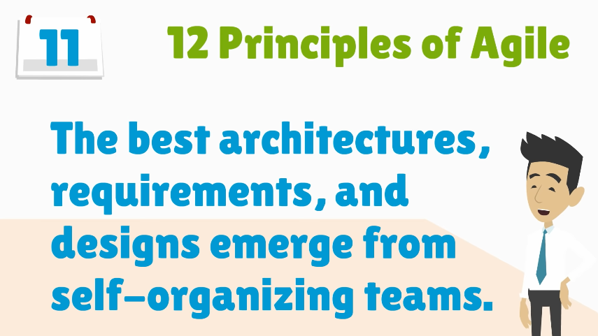

Slide 23
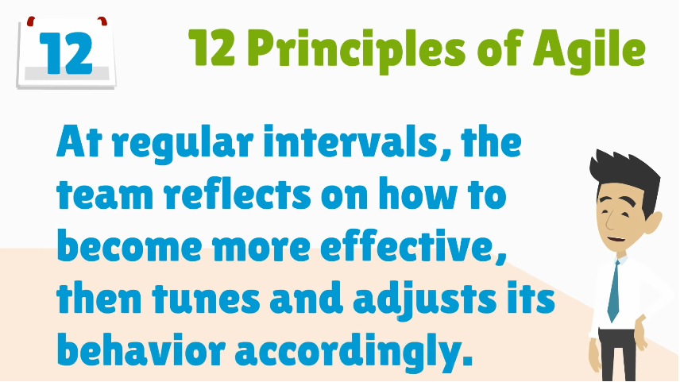

Slide 24
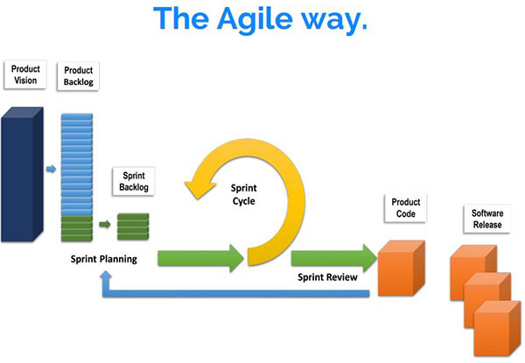

Slide 25
Agile method applicability
Product development where a software company is developing a small or medium-sized product for sale.
– Almost all software products and apps are now developed using an agile approach
Custom system development within an organization, where there is a clear commitment from the customer to become involved in the development process and where there are few external rules and regulations that affect the software.

Slide 26
Agile development techniques

Slide 27
Extreme programming
XP is an example of how Agile can heighten customer satisfaction.
XP is centered on frequent releases and short development cycles.
Extreme Programming (XP) takes an ‘extreme’ approach to iterative development.
New versions may be built several times per day;
Increments are delivered to customers every 2 weeks;
All tests must be run for every build and the build is only accepted if tests run successfully.

Slide 28
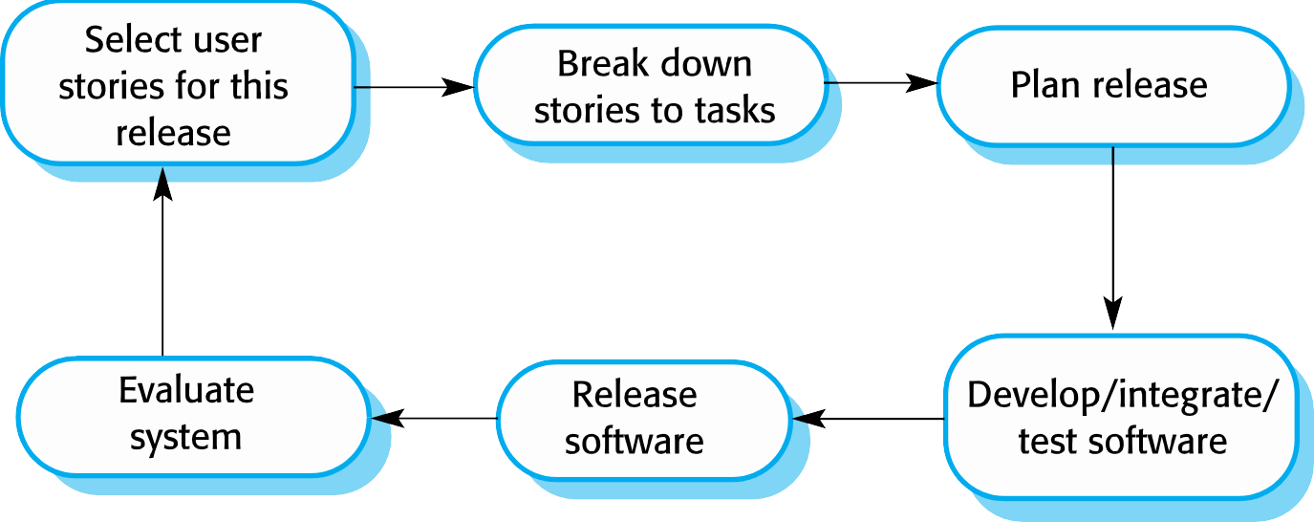
The extreme programming release cycle

Slide 29
Extreme programming practices (a)
Principle or practice | Description
Incremental planning | Requirements are recorded on story cards and the stories to be included in a release are determined by the time available and their relative priority. The developers break these stories into development ‘Tasks’.
Small releases | The minimal useful set of functionality that provides business value is developed first. Releases of the system are frequent and incrementally add functionality to the first release.
Simple design | Enough design is carried out to meet the current requirements and no more.
Test-first development | An automated unit test framework is used to write tests for a new piece of functionality before that functionality itself is implemented.
Refactoring | All developers are expected to refactor the code continuously as soon as possible code improvements are found. This keeps the code simple and maintainable.

Slide 30
Extreme programming practices (b)
Pair programming | Developers work in pairs, checking each other’s work and providing the support to always do a good job.
Collective ownership | The pairs of developers work on all areas of the system, so that no islands of expertise develop and all the developers take responsibility for all of the code. Anyone can change anything.
Continuous integration | As soon as the work on a task is complete, it is integrated into the whole system. After any such integration, all the unit tests in the system must pass.
Sustainable pace | Large amounts of overtime are not considered acceptable as the net effect is often to reduce code quality and medium term productivity
On-site customer | A representative of the end-user of the system (the customer) should be available full time for the use of the XP team. In an extreme programming process, the customer is a member of the development team and is responsible for bringing system requirements to the team for implementation.

Slide 31
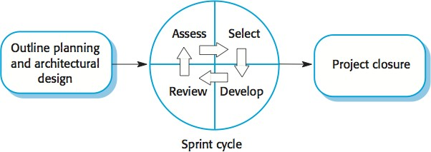
Scrum
Scrum is an agile method that focuses on managing iterative development rather than specific agile practices.

Slide 32
What is Scrum with example?
Scrum is a framework that helps teams work together. Much like a rugby team (where it gets its name) training for the big game, scrum encourages teams to learn through experiences, self-organize while working on a problem, and reflect on their wins and losses to continuously improve

Slide 33
Scrum
There are three phases in Scrum.
The initial phase is an outline planning phase where you establish the general objectives for the project and design the software architecture.
This is followed by a series of sprint cycles, where each cycle develops an increment of the system.
The project closure phase wraps up the project, completes required documentation such as system help frames and user manuals and assesses the lessons learned from the project.

Slide 34
Scrum terminology (a)
Scrum term | Definition
Development team | A self-organizing group of software developers, which should be no more than 7 people. They are responsible for developing the software and other essential project documents.
Potentially shippable product increment | The software increment that is delivered from a sprint. The idea is that this should be ‘potentially shippable’ which means that it is in a finished state and no further work, such as testing, is needed to incorporate it into the final product. In practice, this is not always achievable.
Product backlog | This is a list of ‘to do’ items which the Scrum team must tackle. They may be feature definitions for the software, software requirements, user stories or descriptions of supplementary tasks that are needed, such as architecture definition or user documentation.
Product owner 10/11/2020 | he Scrum Product Owner is usually a project's key stakeholder

Slide 35
Scrum terminology (b)
Scrum term | Definition
Scrum | A daily meeting of the Scrum team that reviews progress and prioritizes work to be done that day. Ideally, this should be a short face-to-face meeting that includes the whole team.
ScrumMaster | The ScrumMaster is responsible for ensuring that the Scrum process is followed and guides the team in the effective use of Scrum. He or she is responsible for interfacing with the rest of the company and for ensuring that the Scrum team is not diverted by outside interference. The Scrum developers are adamant that the ScrumMaster should not be thought of as a project manager. Others, however, may not always find it easy to see the difference.
Sprint | A development iteration. Sprints are usually 2-4 weeks long.
Velocity | An estimate of how much product backlog effort that a team can cover in a single sprint. Understanding a team’s velocity helps them estimate what can be covered in a sprint and provides a basis for measuring improving performance.

Slide 36
Teamwork in Scrum
The ‘Scrum master’ is a facilitator who arranges daily meetings, tracks the backlog of work to be done, records decisions, measures progress against the backlog and communicates with customers and management outside of the team.
The whole team attends short daily meetings (Scrums) where all team members share information, describe their progress since the last meeting, problems that have arisen and what is planned for the following day.
– This means that everyone on the team knows what is going on and, if problems arise, can re-plan short- term work to cope with them.

Slide 37
Scrum benefits
The product is broken down into a set of manageable and understandable chunks.
Unstable requirements do not hold up progress.
The whole team have visibility of everything and consequently team communication is improved.
Customers see on-time delivery of increments and gain feedback on how the product works.
Trust between customers and developers is established and a positive culture is created in which everyone expects the project to succeed.

Slide 38
Agile project management
The principal responsibility of software project managers is to manage the project so that the software is delivered on time and within the planned budget for the project.
The standard approach to project management is plan- driven. Managers draw up a plan for the project showing what should be delivered, when it should be delivered and who will work on the development of the project deliverables.
Agile project management requires a different approach, which is adapted to incremental development and the practices used in agile methods.

